Slide 1


Powered by
Altair Rapidminer Studio
Stock Prediction
Analysis
Stanley A
Loyola ICAM College Of Engineering and Technology

Slide 2
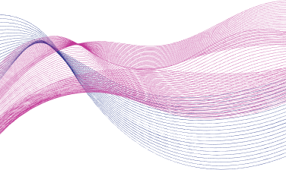

INTRODUCTION
Stock prediction analysis involves forecasting the future price movements of stocks using various analytical methods.
Microsoft Corporation (MSFT), as one of the world's leading technology companies, offers a rich dataset and numerous variables for such analysis.
The goal is to identify patterns and signals that can provide insights into potential price movements, aiding investors in making informed decisions.

Slide 3

OBJECTIVES
01
Accurate Forecasting
02
Risk and Trend Analysis
Develop reliable models to predict Microsoft’s future stock prices with minimal errors.
Identify trends and assess risks to understand the factors influencing Microsoft’s stock performance.
03
Strategic Investment Planning
04
Continuous Model Improvement
Create data-driven investment strategies to optimize returns and resource allocation.
Ensure predictive models remain accurate and robust through ongoing validation and adjustments.

Slide 4
BENEFITS
01
Informed Decision-Making
02
Risk Management
Empower investors to make better decisions about buying, holding, or selling Microsoft stock.
Improve risk assessment and mitigation strategies to safeguard investments.
03
Optimized Returns
04
Market Insight
Identify optimal entry and exit points to maximize investment returns.
Gain a deeper understanding of market dynamics and the factors driving Microsoft's stock performance.

Slide 5







Attributes Used
Date
Open
The price at which a stock first trades upon the opening of the trading day.
Every day from
April 2015 to
March 2021
High
Low
The highest price at which a stock trades during the trading day
The lowest price at which a stock trades during the trading day
Close
Volume
The last price at which a stock trades at the end of the trading day.
The number of stocks been sold each day

Slide 6
BUILDING MODEL
Pre Process Panel | Auto Model
Decision Tree | Generalized Linear Model
Naive Bayes | Random Forest
SVM | Deep Learning

Slide 7

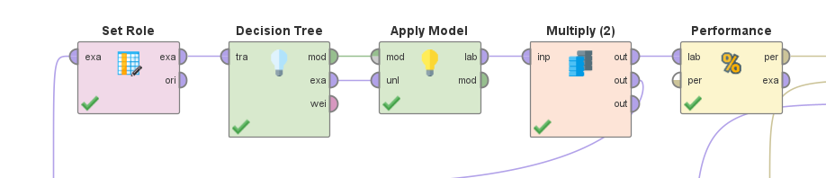
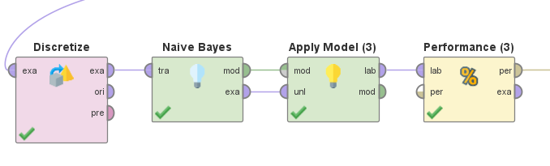
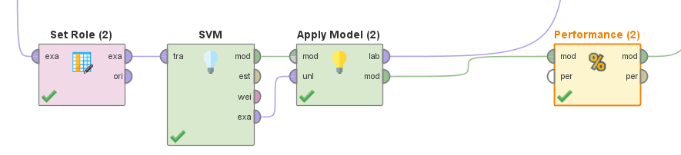
Decision Tree
PreProcess
PANEL
Naive Bayes
Preprocess panel mainly consists of 3 Models, namely:
Decision Tree
Naive Bayes
Support Vector Machine
along with its Performance
SVM

Slide 8
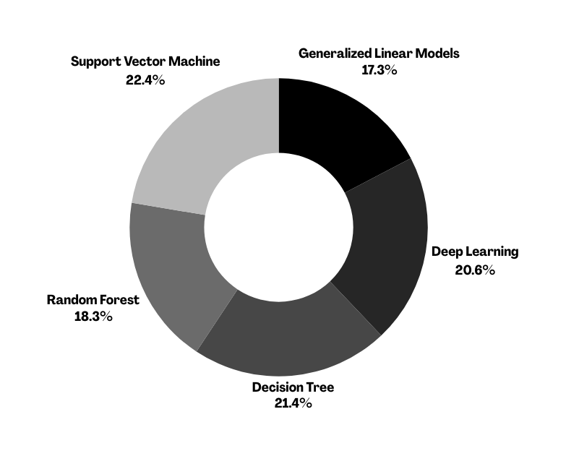
Auto
MODEL
We have build the auto Model ton predict the Volume( Number of stocks sold) based on the Highest and Lowest Stock rate.
Here Models such as:
Generalized Linear Models
Deep Learning
Decision Tree
Random Forest
Support Vector Machine
Gradient Boosted Trees
and much more are build using Auto Model
This is an example using Auto Model to predict the Root Mean Squared Error

Slide 9
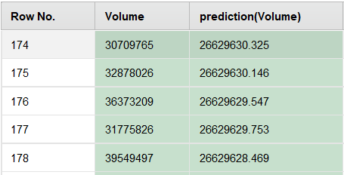
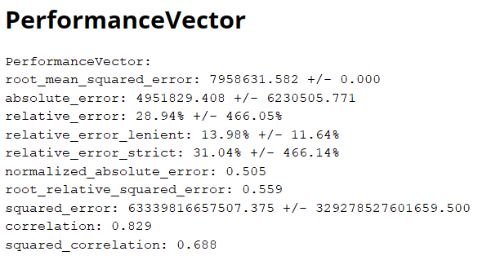
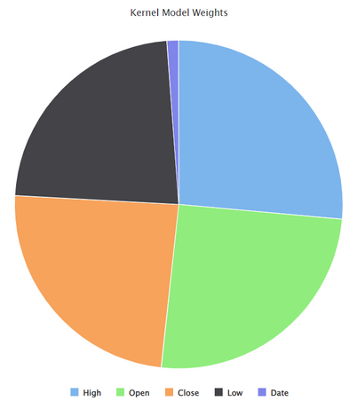
RESULT ANALYSIS
2.NAIVE BAYES
Preprocess Panel Inference is discussed here:
1.DECISION TREE
This indicates the performance based on the decision model built
3.SUPPORT VECTOR MACHINE
This svm model is used to anticipate the weights and performance
This indicates the performance based on the decision model built
Weight Chart ------>

Slide 10
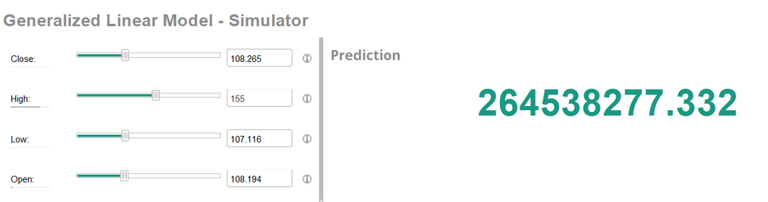
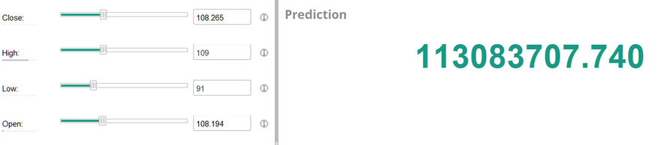
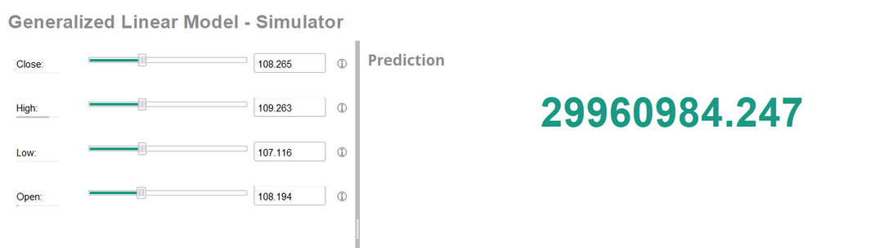

Auto Model
SIMULATOR
The predictions are as follows :
Here we use simulator embedded within Generalized Linear model to predict the Volume based on the dataset.
It varies based on 3 attributes namely:
1.High
2.Low
For high == 155
For low == 91
These are just the predictions similar to Naive Bayes prediction done previously.
Therefore , they may vary.
This is the standard value for input as
High - 109
Low - 107

Slide 11





THANK YOU
Contact Us
Stanley A
Student - Loyola ICAM
9941127755
stanley.25it@licet.ac.in

